Slide 1

CryptoCurrency Price Predictions with K Nearest Neighbour WQD7005 DATA MINING
Lim Kaomin,leslie
wqd180076

Slide 2
Data Pipeline
Data Collection
Data Cleaning/Pre-processing
Data Analysis/Visualization
Data Modelling
Evaluation
Web scrapping
Pandas python
Remove regular expressions
Matplot plot
Seaborn plot
Confusion Matrix
RMSE
Sentiment Analysis of news headlines
Feature Engineering
Adding new columns to news and crypto price datasets
K-Nearest NeighbourRegression
K-nearest NeighbourClassifier
Preparation before modelling
Merging Dataframes
3 Datasets Created
Train , testing dataset

Slide 3
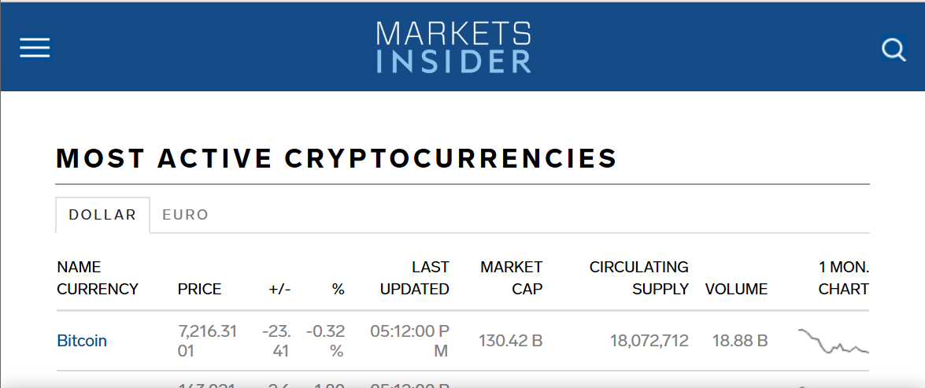
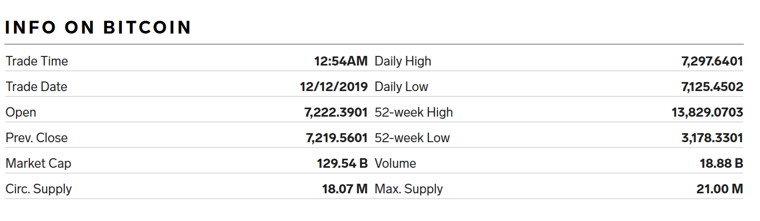
Data Collection
Crypto Price data collected using Web scraping library
BeautifulSoup
https://markets.businessinsider.com/cryptocurrencies

Slide 4
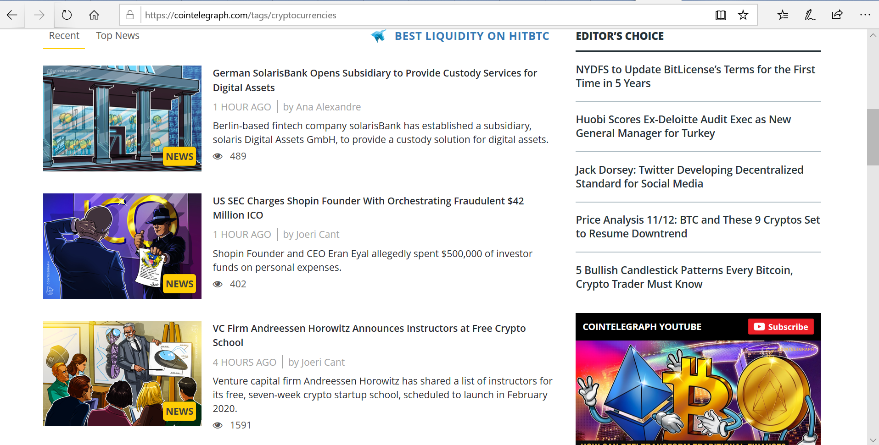
News headlines collected using also BeautifulSoup
Collected data for Article Date, Headlines and Sub headlines
https://cointelegraph.com/tags/cryptocurrencies

Slide 5
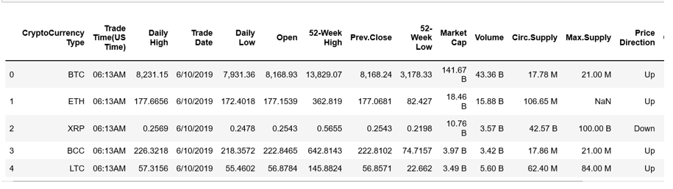
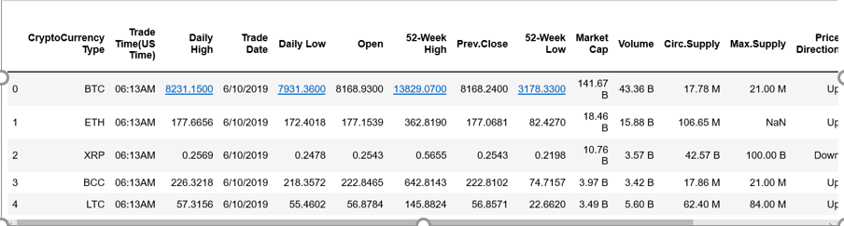
Data Pre-processing
For cryptocurrency dataset, Daily High, Daily Low, Open, 52-Week High, Prev.Close and 52-Week Low have commas, remove commas using ‘re’ then converted to float

Slide 6
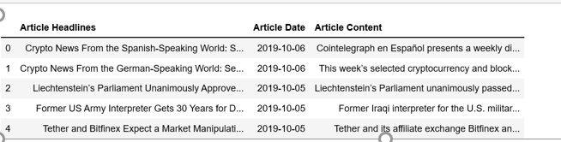
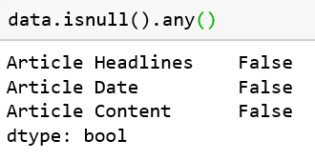
For news headlines dataset not much pre processing needed as the dataset does not have missing values

Slide 7

News Sentiment Analysis
Using TextBlob to perform Sentiment Analysis
Before moving forward to calculate the sentiment scores for each review it is important to pre-process the textual data
Pre-processing textual data:
Lowercasing
Removing Special Characters
Removing Stopwords
This Photo by Unknown Author is licensed under CC BY-SA

Slide 8
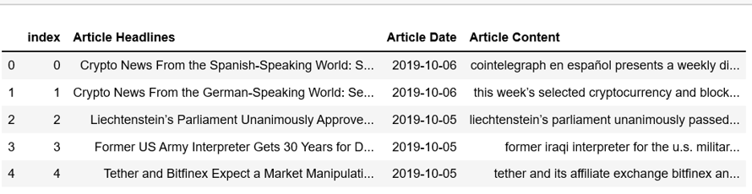
Lowercasing
Lowercasing helps in the process of normalization which is an important step to keep the words in a uniform manner.

Slide 9
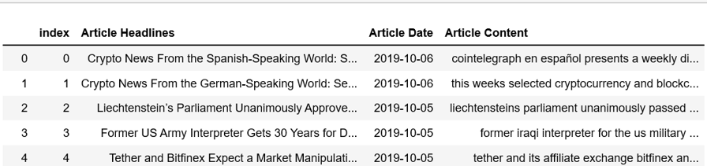
Removing Special Characters
Special characters are non-alphabetic and non-numeric values such as {!,@#$%^ *()~;:/<>\|+_-[]?} are removed as it might interfere in the sentiment score

Slide 10
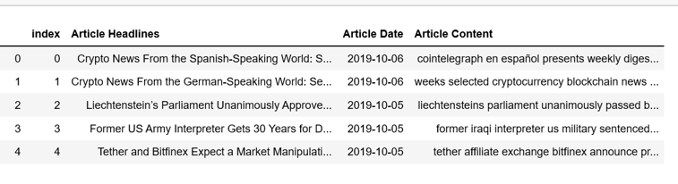
Removing Stopwords
Stop-words being most commonly used in the English language; however, these words have no predictive power in reality. Words such as I, me, myself, he, she, they, our, mine, you, yours etc.

Slide 11

News Sentiment Score Using TextBlob
If score >0 ,assign positive
Else score < 0, assign negative
Else score = 0,
Assign neutral

Slide 12
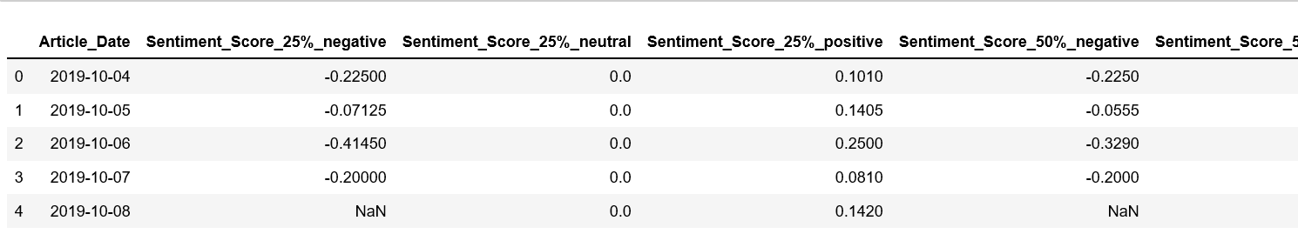
News Sentiment Score Using TextBlob…..cont
Columns in new news headlines dataset:
Sentiment_Score_20%: negative, neutral, positive
Sentiment_Score_50%: negative, neutral, positive
Sentiment_Score_80%: negative, neutral, positive
Sentiment_Score_count: negative, neutral, positive
Sentiment_Score_max : negative, neutral, positive
Sentiment_Score_min: negative, neutral, positive
Sentiment_Score_std: negative, neutral, positive

Slide 13
Data Visualization
Line Chart for BitCoin, Ethereum and LiteCoin
Waterfall Chart to visualize Cryptocurrency prices
Barchart to visualize News Header Sentiment Score

Slide 14
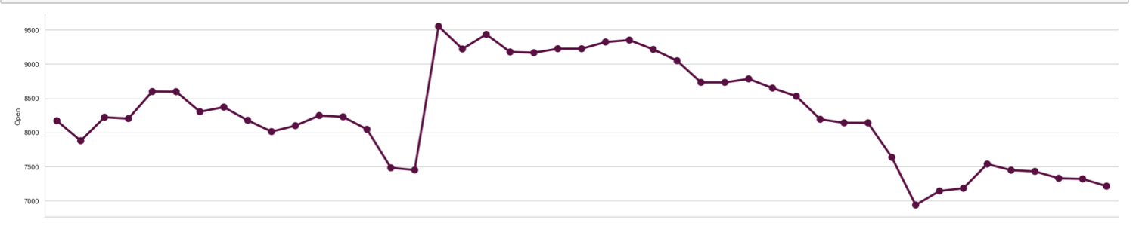
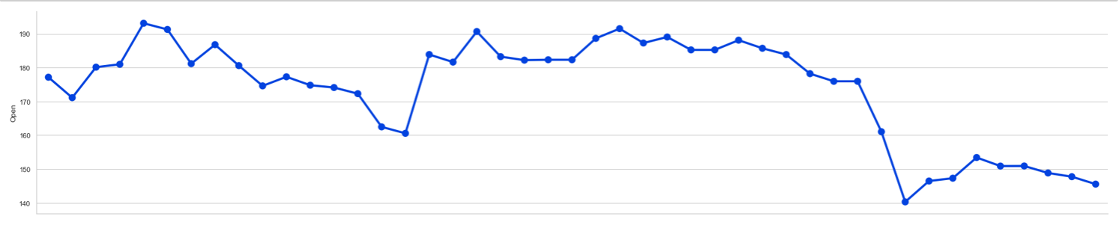
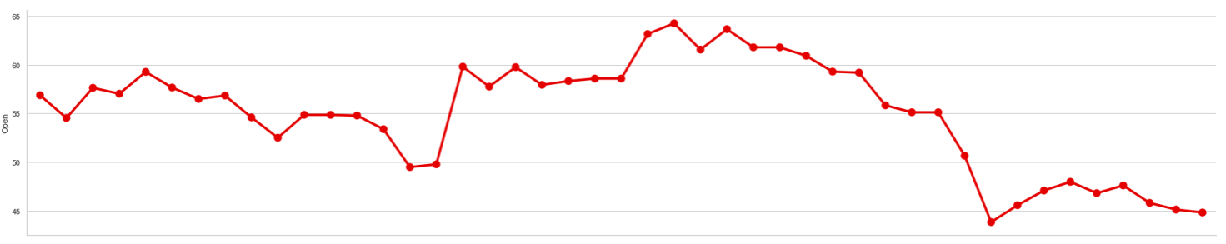
BitCoin
21/11~20/11
20/10~28/10
Ethereum
LiteCoin

Slide 15
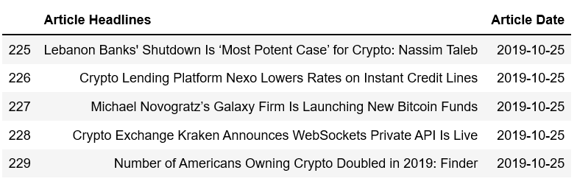
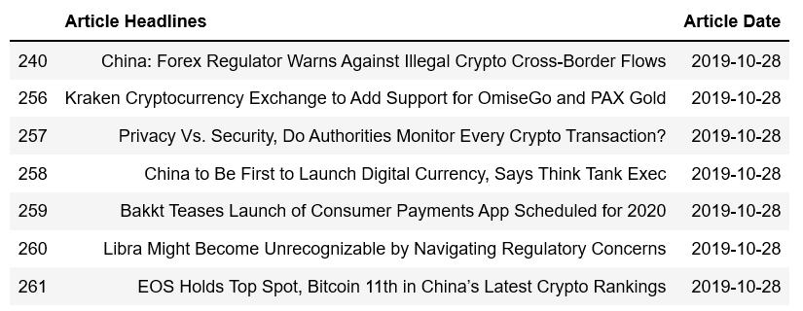
POSITIVE NEWS HEADLINES

Slide 16
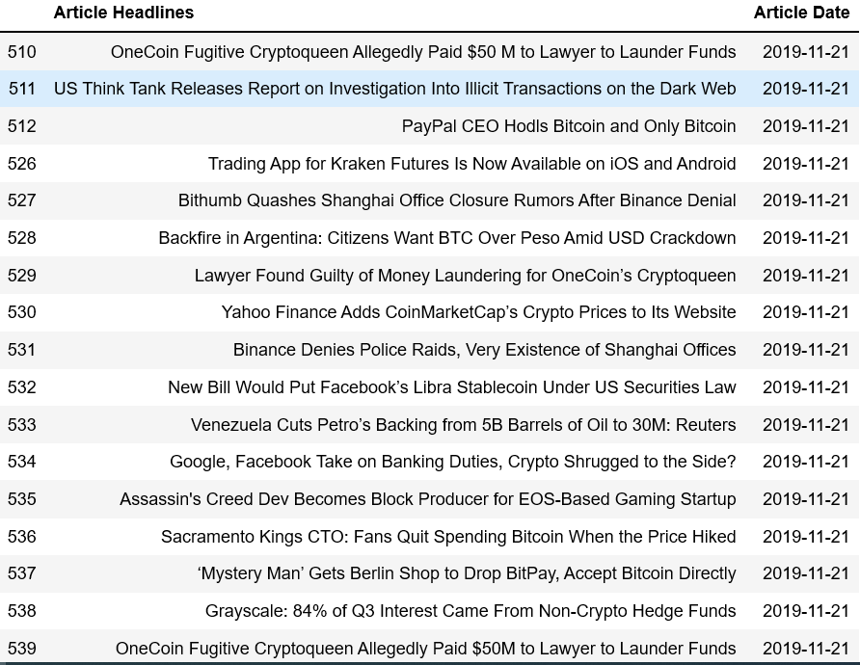
NEGATIVE
NEWS
HEADLINES

Slide 17
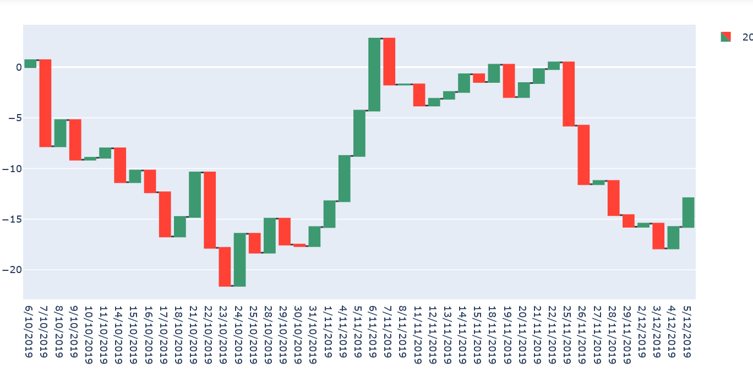
Price Change(Open – Prev.Close)- BitCoin

Slide 18
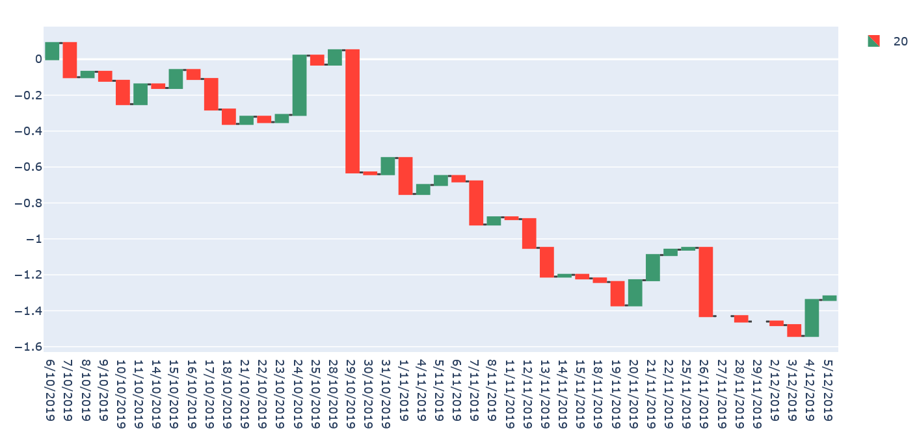
Price Change(Open – Prev.Close)- Ethereum

Slide 19
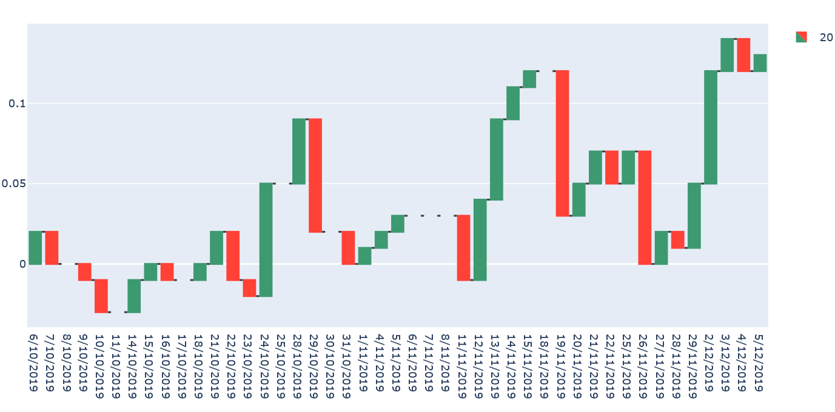
Price Change(Open – Prev.Close)- Litecoin

Slide 20
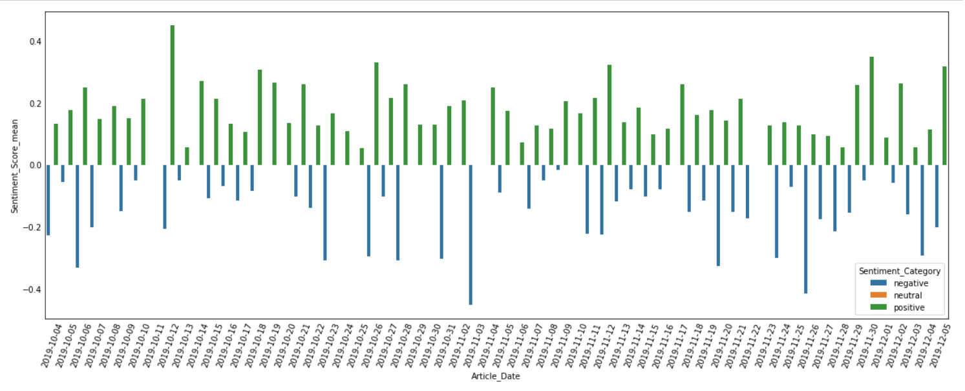
News Sentiment Score with Article Date (Note :Not Showing Neutral)

Slide 21
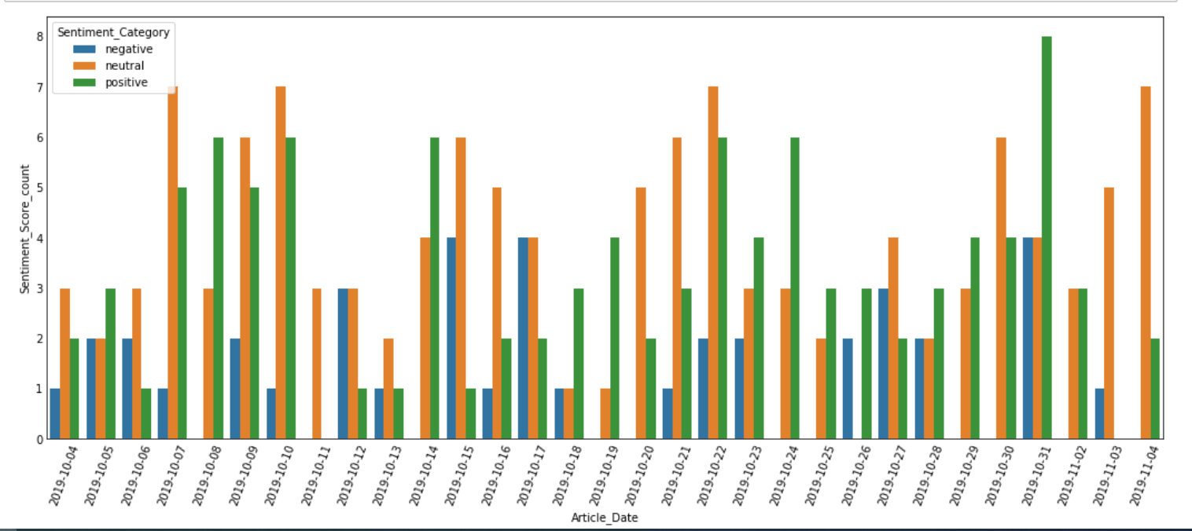
News Sentiment Score with Article Date (Note :Not Showing All Date)

Slide 22
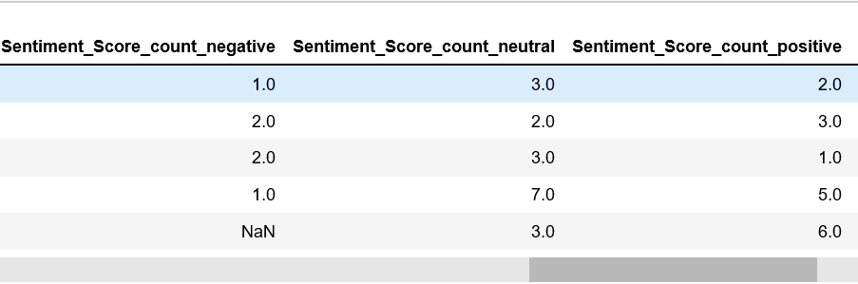
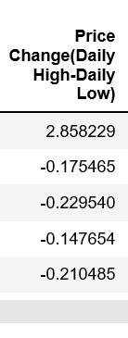
Feature Engineering
Feature Engineering aims to create useful features that can enhance the machine learning model
New Column features for Crypto price dataset
New Column features for News Headlines dataset

Slide 23
Preparation of Dataset before Modelling
Merging of DataFrames
1) Merging DataFrames
2) Three Dataset used for modelling:
- Original Dataset
- StandardScaled Dataset
- Feature Selected Dataset
3) Train, Test Split
Crypto Price dataset
Merging of dataframes with left join on ‘Trade Date’ and ‘Article Date’
News Headlines dataset
Note: Further pre-processing was also done here:
Fill in null values after merging
convert datetime format to pd datetime

Slide 24
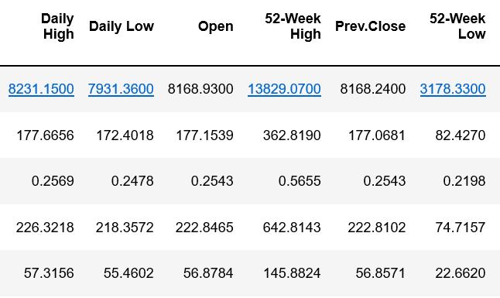
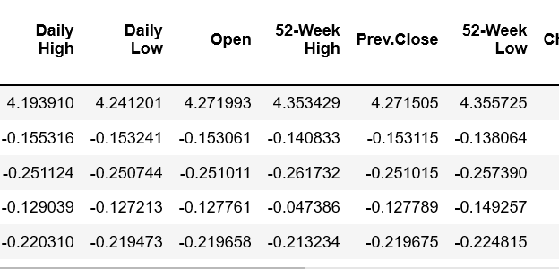
Preparation of Dataset before Modelling
Three Dataset used for modelling:
Original Dataset
StandardScaled Dataset
Feature Selected Dataset
2) StandardScaled Dataset using Standard Scaler to normalize the dataset
1) Original Dataset

Slide 25
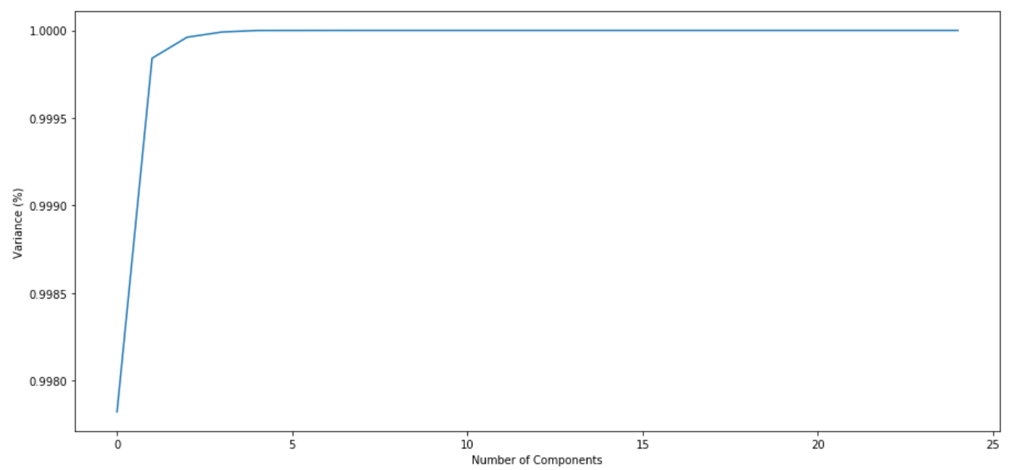
Preparation of Dataset before Modelling
3) Feature Selected Dataset
Selecting useful features for dataset helps reduce the curse of dimensionality on the machine learning model performance
Number of components chosen using PCA
The Feature Selection was done using f_classif and SelectKBest from sklearn library to select n_components with high variance.
The n_components selected was 5

Slide 26
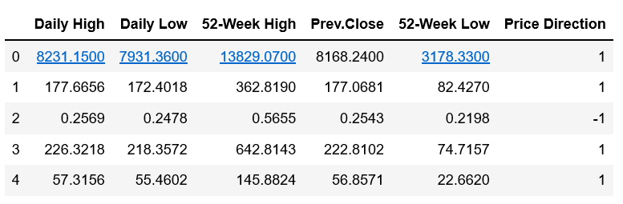
Preparation of Dataset before Modelling
3) Feature Selected Dataset
f_classif calculate the ANOVA of the columns and the SelectKBest picks the columns with high ANOVA
Three Dataset used for modelling:
Original Dataset
StandardScaled Dataset
Feature Selected Dataset

Slide 27
Preparation of Dataset before Modelling
1) Merging DataFrames
2) Three Dataset used for modelling:
- Original Dataset
- StandardScaled Dataset
- Feature Selected Dataset
3) Train, Test Split

Slide 28
Train, Test Split
Original Dataset
Standard
Scaled
Dataset
Feature Selected Dataset
80% Train
80% Train
20% Test
80% Train
20% Test
20% Test

Slide 29
Modelling and Performance Evaluation
Two Models used in this project. One for predicting Crypto Price ‘Up’ or ‘Down’ (Classification).
Other model used to predict difference between Predicted Price and Actual Price( Regression).
Predict Price ‘Up’ or ‘Down’’ done with K Nearest NeighbourClassifier (Price_Direction column as Target)
Predict Predicted Price with Actual Price done with K Nearest NeighbourRegressor (Open Price column as Target)
Model
80% Train
20% Test

Slide 30
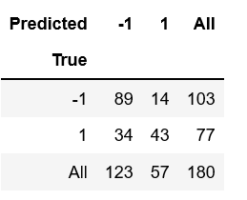
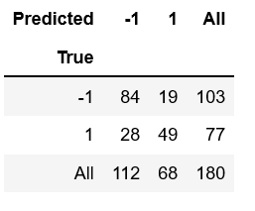
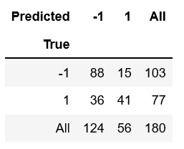
Performance Evaluation
Results evaluated using Confusion Matrix
Results for predicting whether prices go ‘Up’ or ‘Down’
 | Original | Standard Scaled | Feature Selection
Accuracy Rate | 73.34% | 73.89% | 71.67%

Slide 31
Performance Evaluation
Results evaluated using RMSE
Results for predicting differences between Actual Value and Predicted Value of ‘Open’ price
 | Original | Feature Selection
RMSE | 7.838 | 6.937

Slide 32
Discussion
StandardScaled Dataset showed the highest accuracy using the KNN Classifier however the dataset was unapplicable to KNN Regressor as the dataset has been scaled, thus giving a small RMSE which was misleading.
Feature Selected Dataset only used 5 columns which non are news sentiment score columns, and achieved 71.67% accuracy with KNN Classifier and RMSE of 6.937 with KNN Regressor. Which means the news sentiment scores has little effect on crypto prices.
However, the Original Dataset and StandardScaled dataset which takes in to account news sentiment score columns achieved better accuracy.

